Slide 1
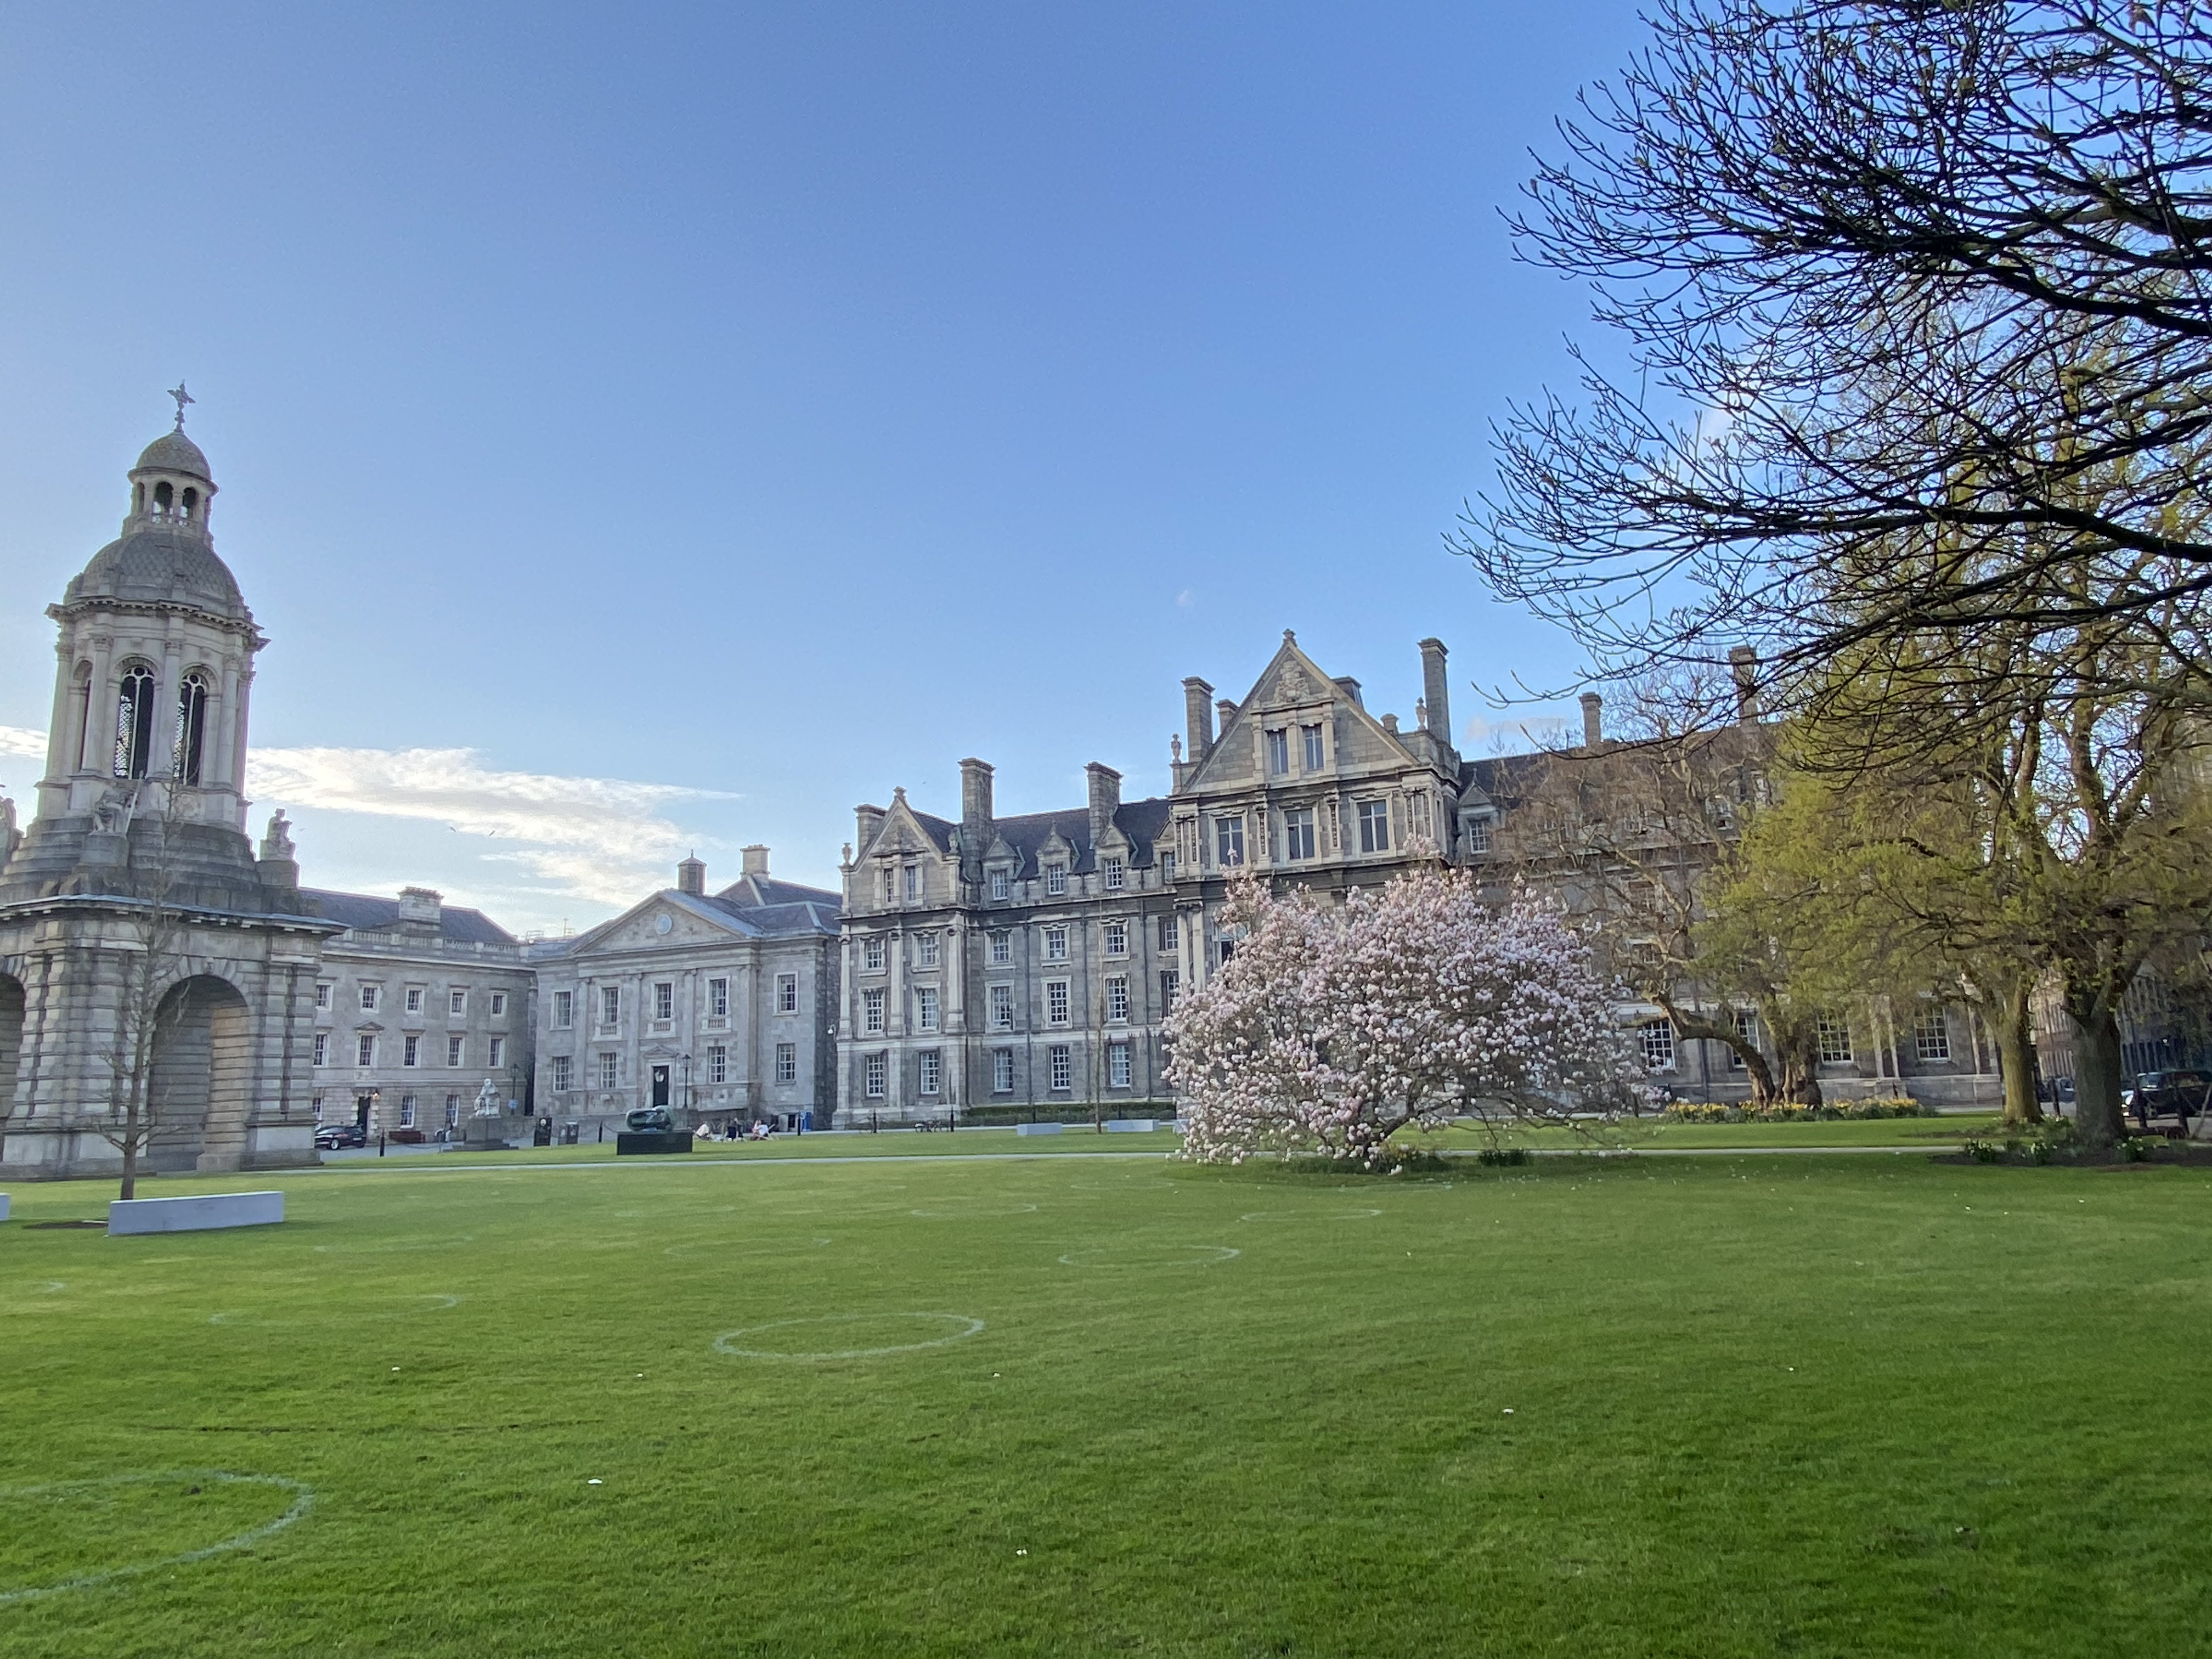
Welcome from the Dean of Graduate Studies
Fáiltiú ón Déan an Léinn Iarchéime

Slide 2

This Session
The University
Your School
The Office of the Dean of Graduate Studies
Your Postgraduate Journey
The Structured PhD

Slide 3

Student Body 2025-26
Dean of Graduate Studies
Senior Lecturer, Dean of Undergraduate Studies
Dean of Students

Slide 4
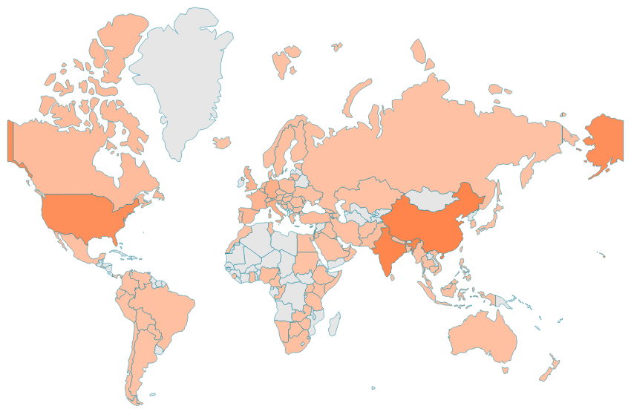
Our global PG student community - >3,300 students

Slide 5
University
AHSS
STEM
HS
12 Schools:
Business
Creative Arts
Education
English
History & Humanities
Languages, Literature & Cultural Studies
Law
Linguistic, Speech & Communication Sciences;
Psychology
Religion, Theology, & Peace Studies
Social Science & Philosophy
Social Work & Social Policy
8 Schools:
Biochemistry & Immunology
Chemistry
Computer Science & Statistics
Engineering
Genetics & Microbiology
Mathematics
Natural Sciences
Physics
4 Schools:
Dental Science
Medicine
Nursing & Midwifery
Pharmacy & Pharmaceutical Sciences

Slide 6
School based supports
PGR PGT
Director of Postgraduate Teaching and Learning
Coordinator of PhD/Research Students
Course Admin Office
Supervisor(s)
Thesis committee
Research group/lab
School Appeal Committee
Director of Postgraduate Teaching and Learning
Coordinator of PGT Students
Course Admin Office
Course Director
Module coordinator
Course committee
School Appeal Committee

Slide 7
Postgraduate Advisory Support Service
Student Counselling
AMLCT/TCDSU
Dean of Graduate Studies
Graduate Studies Office
Global Engagement
Health Services
Careers
Student Learning & Development
Academic Registry
DisAbility Services

Slide 8
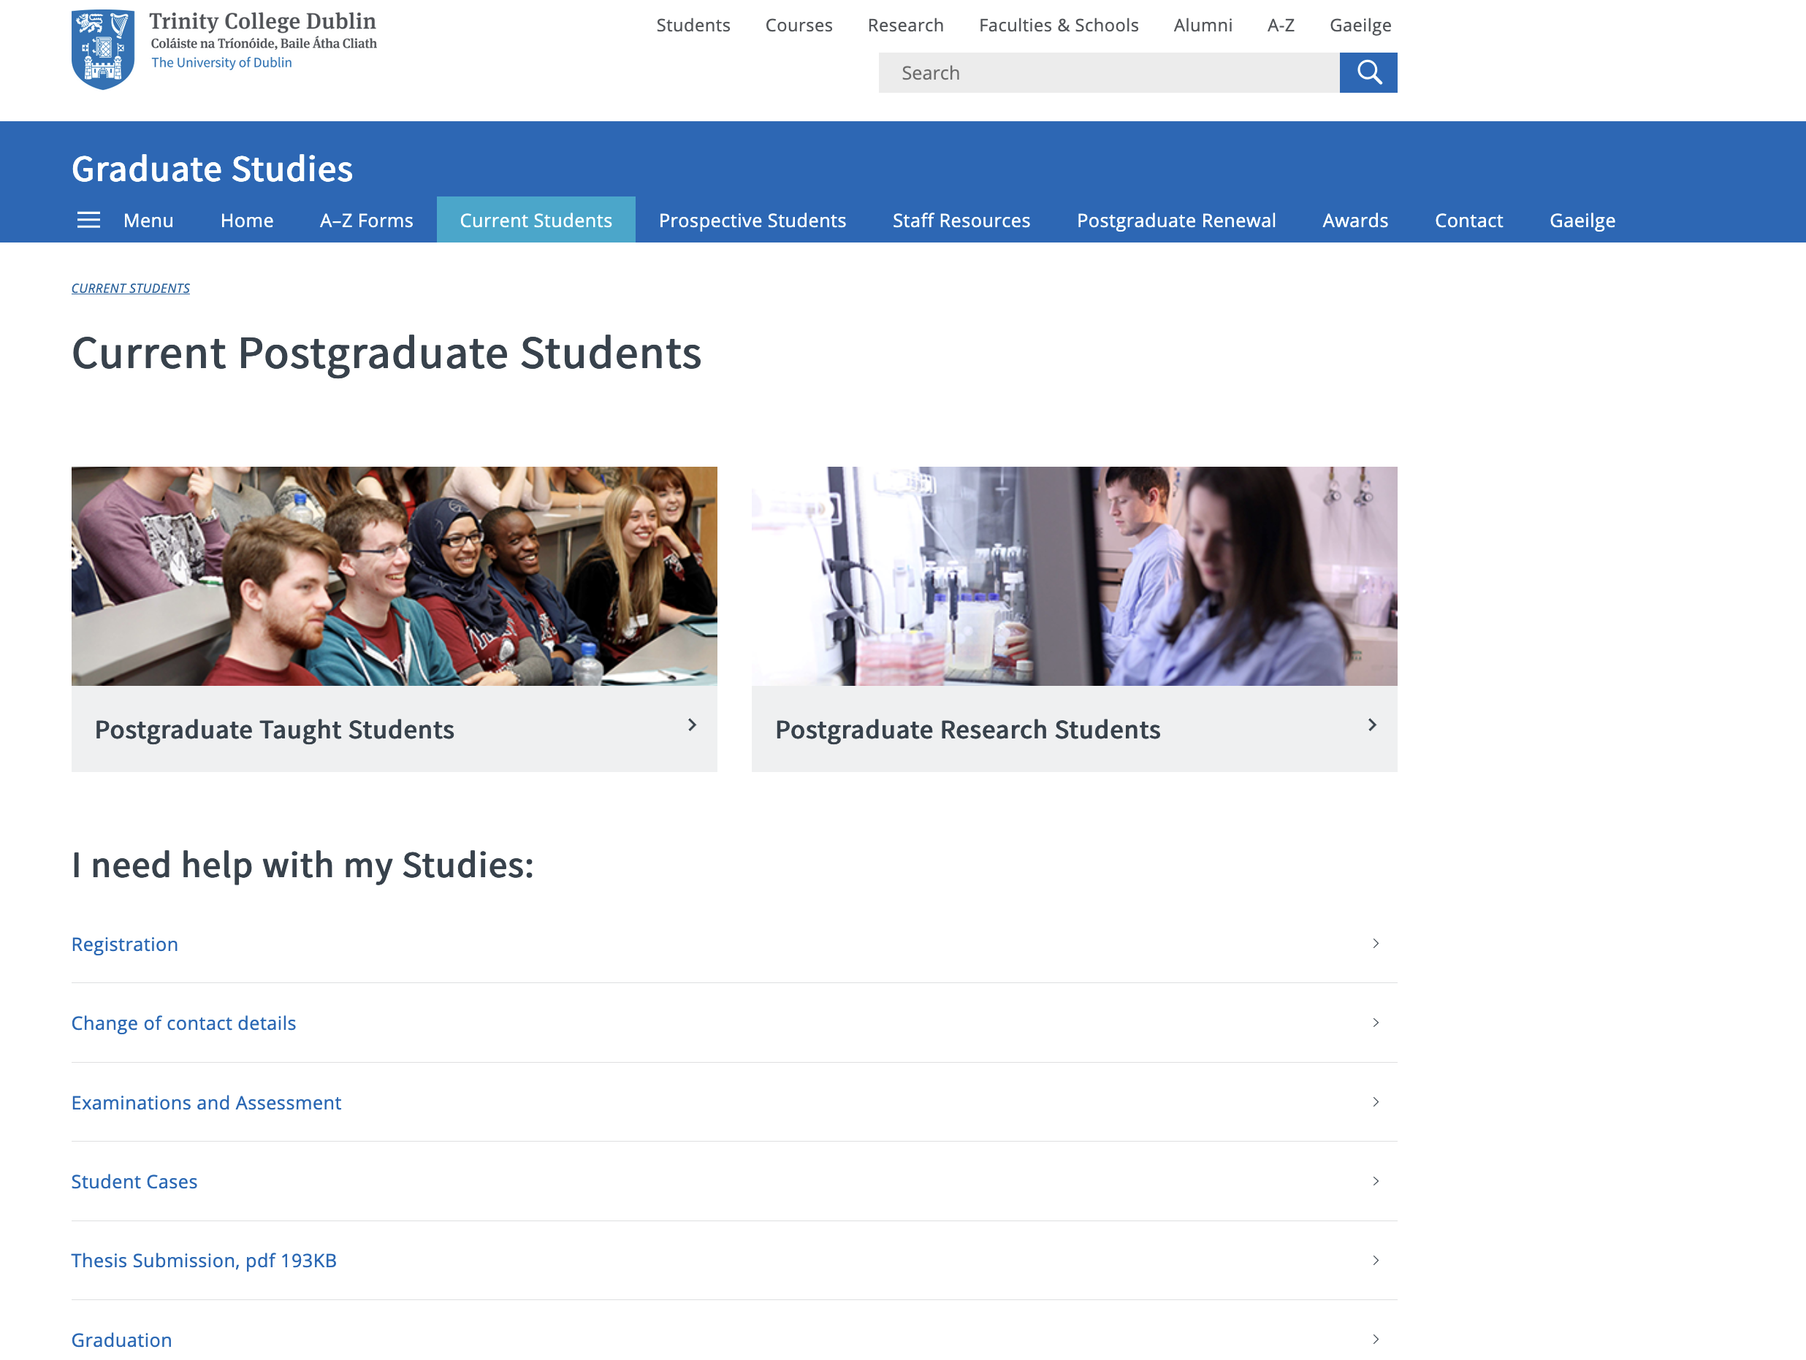
https://www.tcd.ie/graduatestudies/

Slide 9
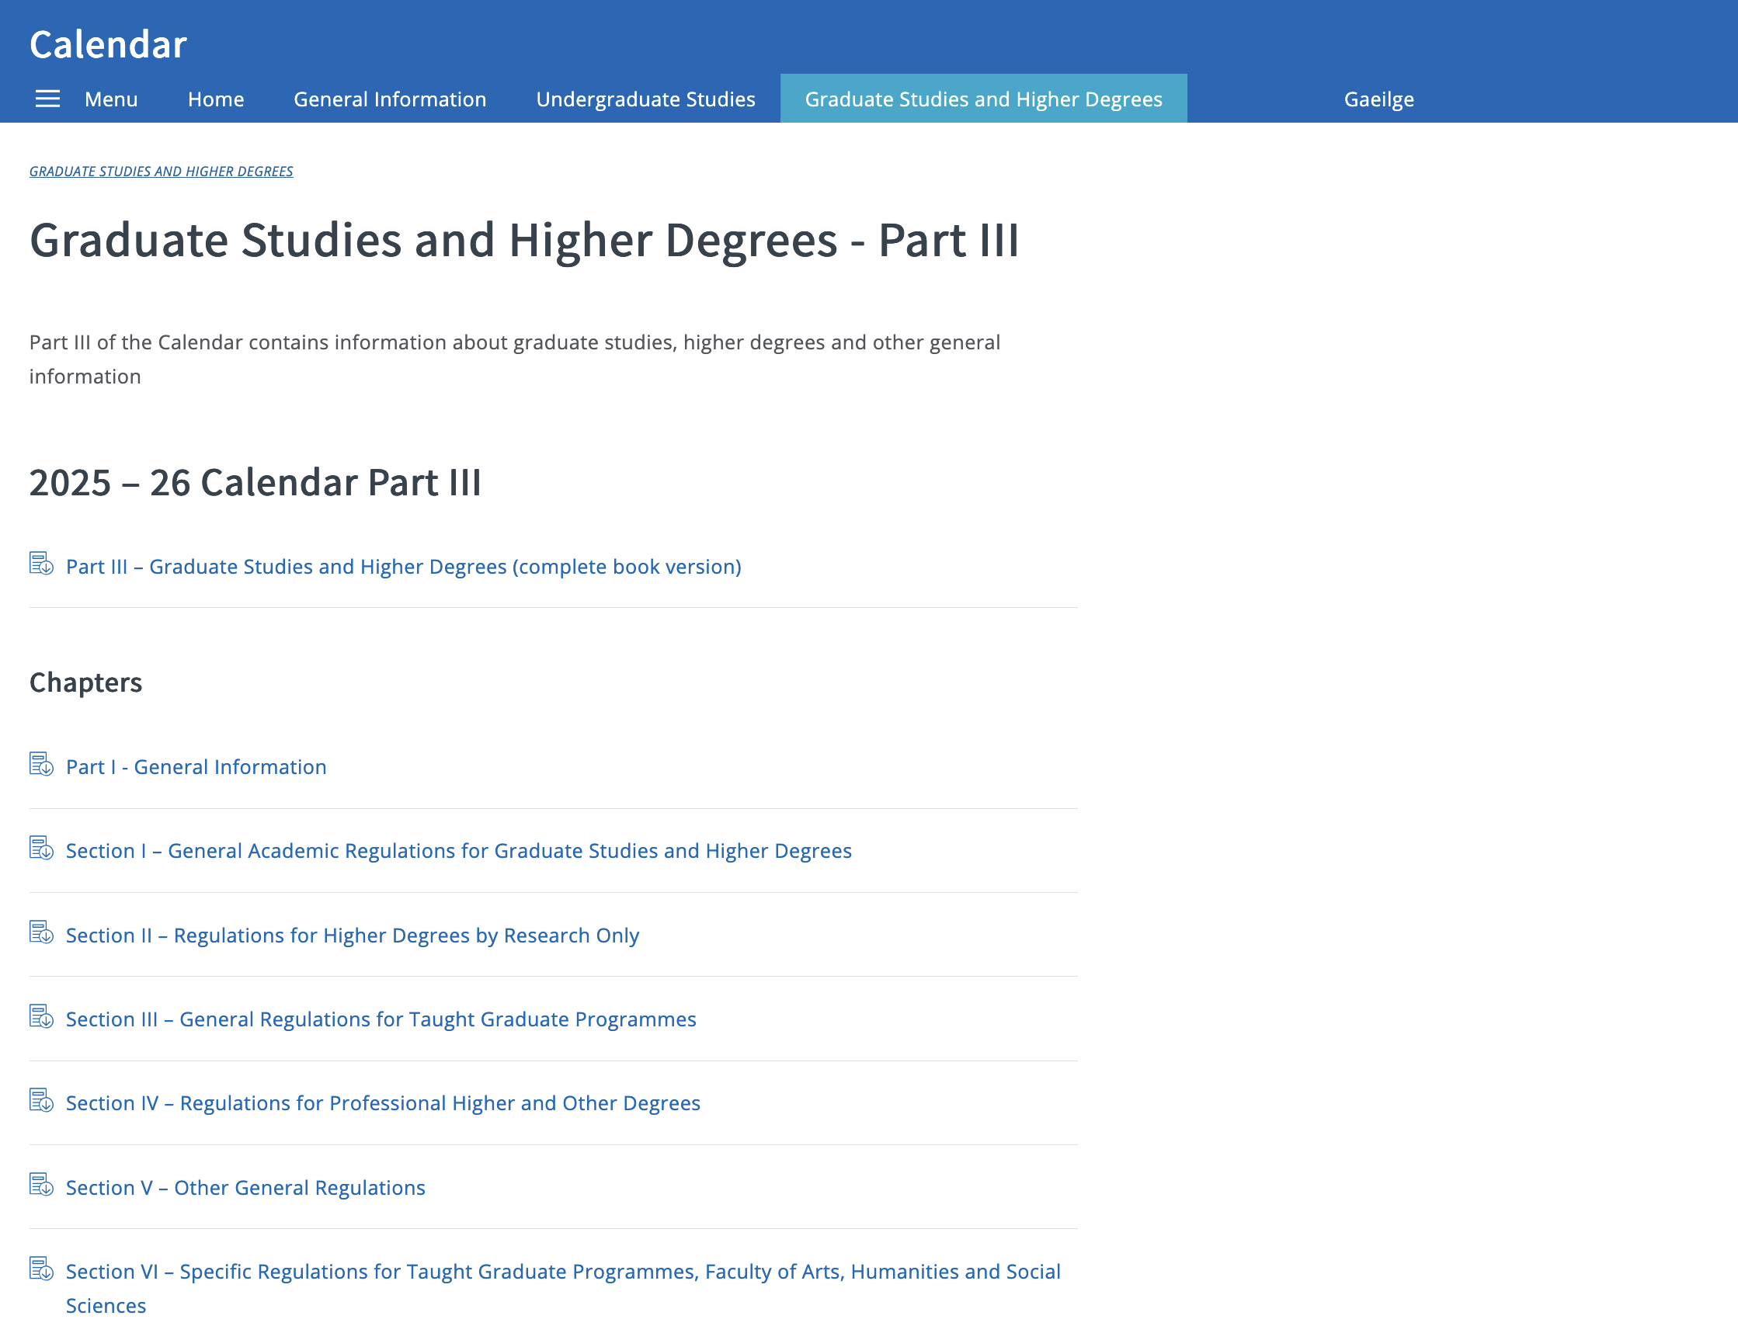
Finding information…
Postgraduate Advisory Support Service
Local School handbook
Course Director
Research supervisor
  Thesis committee
Director of PG Teaching & Learning
Head of School
Dean of Graduate Studies
Aontas Mac Léinn
Students’ Union

Slide 10

Our Vision for Postgraduate Education at Trinity …

Slide 11
What we want for our postgraduate students
Inclusion, Belonging, Connection
Learn and Grow
Contribute to the university
Fulfil ambitions
Have impact and stay connected

Slide 12
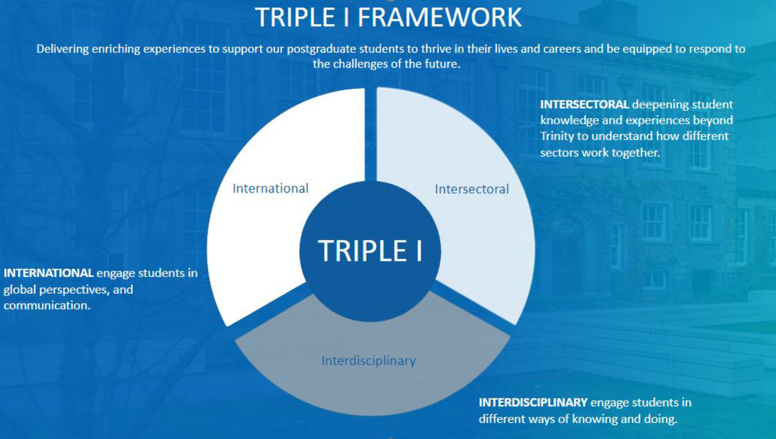

Slide 13
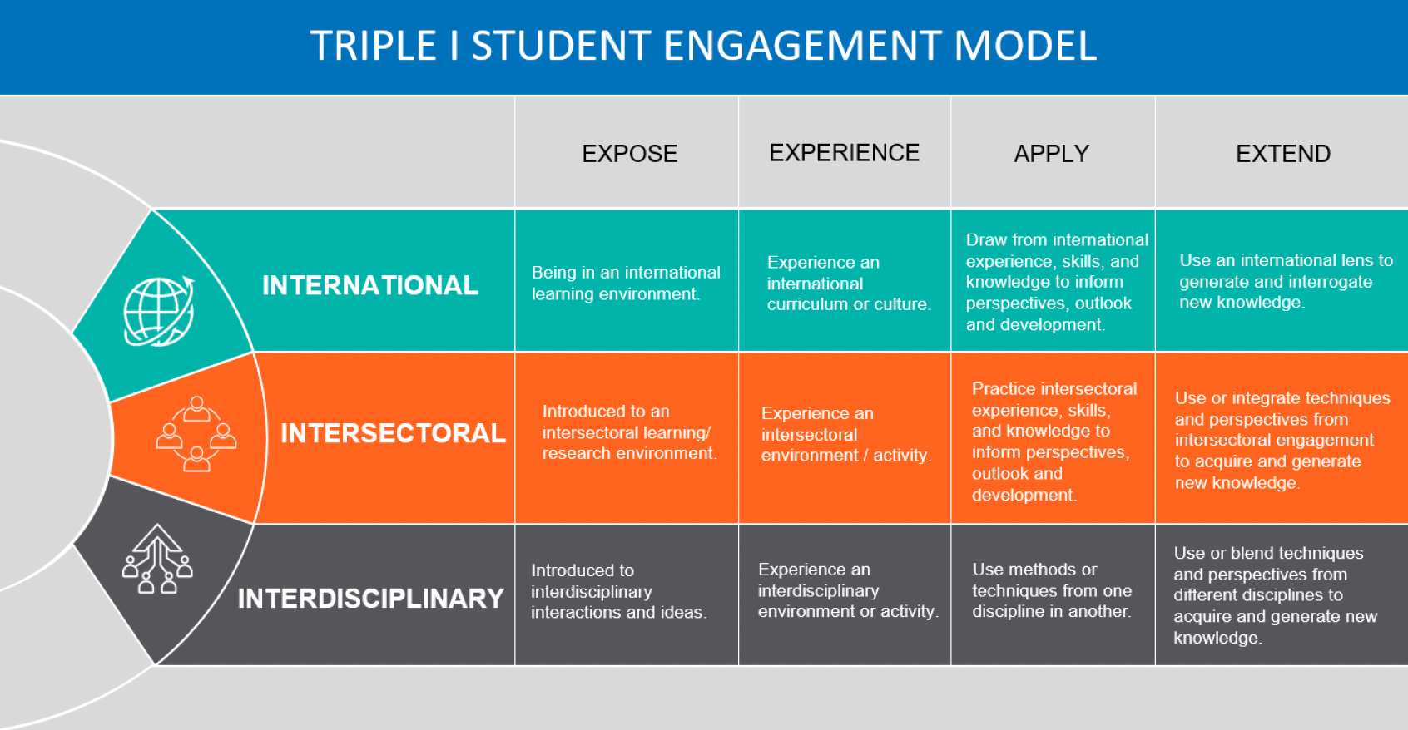
Trinity’s Triple I commitment: Interdisciplinary, International, Intersectoral

Slide 14
Researcher development in Trinity
Academic
Strand
Year 2
Year 3
Year 4
Year 4+
Year 1
Personal/Professional
Strand

Slide 15
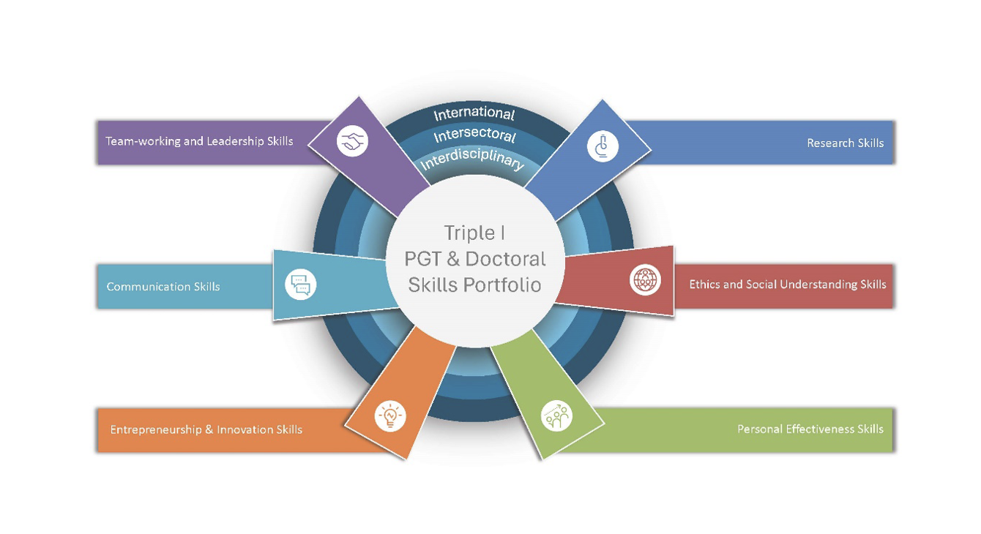

Slide 16
Scholarship in Trinity
Academic Integrity
Guides and Resources
We commit ourselves as staff and students to acting responsibly and ethically, embracing integrity in all our actions and interactions as members of the College community, underpinned by principles of honesty, transparency and accountability
Build on the work of others with integrity, openly and explicitly with due acknowledgement
Academic Misconduct
Library support
Student Learning & Development

Slide 17
Scholarship in Trinity
Research Integrity
“…research shall be conducted ethically and with integrity and shall be founded on the principles of honesty, reliability, objectivity, impartiality, independence, fairness, respect, accountability, open communication, compliance with duties of care, and responsibility for future generations of researchers”.
(Policy on Good Research Practice, p.3)

Slide 18

Artificial Intelligence, GenAI
Competent, critical, ethical, responsible users
College Statement sets out core principles of:
High Level Principles for Postgraduate Researchers on the use of Generative AI during Doctoral Programmes
Transparency and honesty
Responsibility and accountability
Respect
Innovation
This Photo by Unknown Author is licensed under CC BY-NC-ND

Slide 19
Transparency and honesty: give clear, fair, impartial and appropriate acknowledgement and citation to any role that AI and GenAI have played in our teaching, learning, assessment and research
Our own responsibility and accountability for our use and for the output we create, abiding by College policies and other relevant policies and legislation
Respect: for colleagues, students, research participants, the environment and cultural heritage in our use of AI and GenAI, demonstrating respect for intellectual property, personal and sensitive data, and confidential information
Innovation: harness the potential of AI and GenAI, while recognizing that creativity and innovation must be balanced by responsibility, integrity, transparency and sustainability at all times

Slide 20
Maximizing your success
Plan your time
Familiarize yourself with the regulations
Read the handbook!
Academic integrity
Seek support

Slide 21

Bumps in the Road
Try to be proactive
Make requests (e.g., Off Books) through your course director, or your supervisor
Remember the DTLPG – the next source of help within your School
Postgraduate Advisory Service
AMLCT/TCDSU

Slide 22
And remember….
Let us know how to improve
genadgso@tcd.ie
Take the opportunity to
impact future PG students

Slide 23
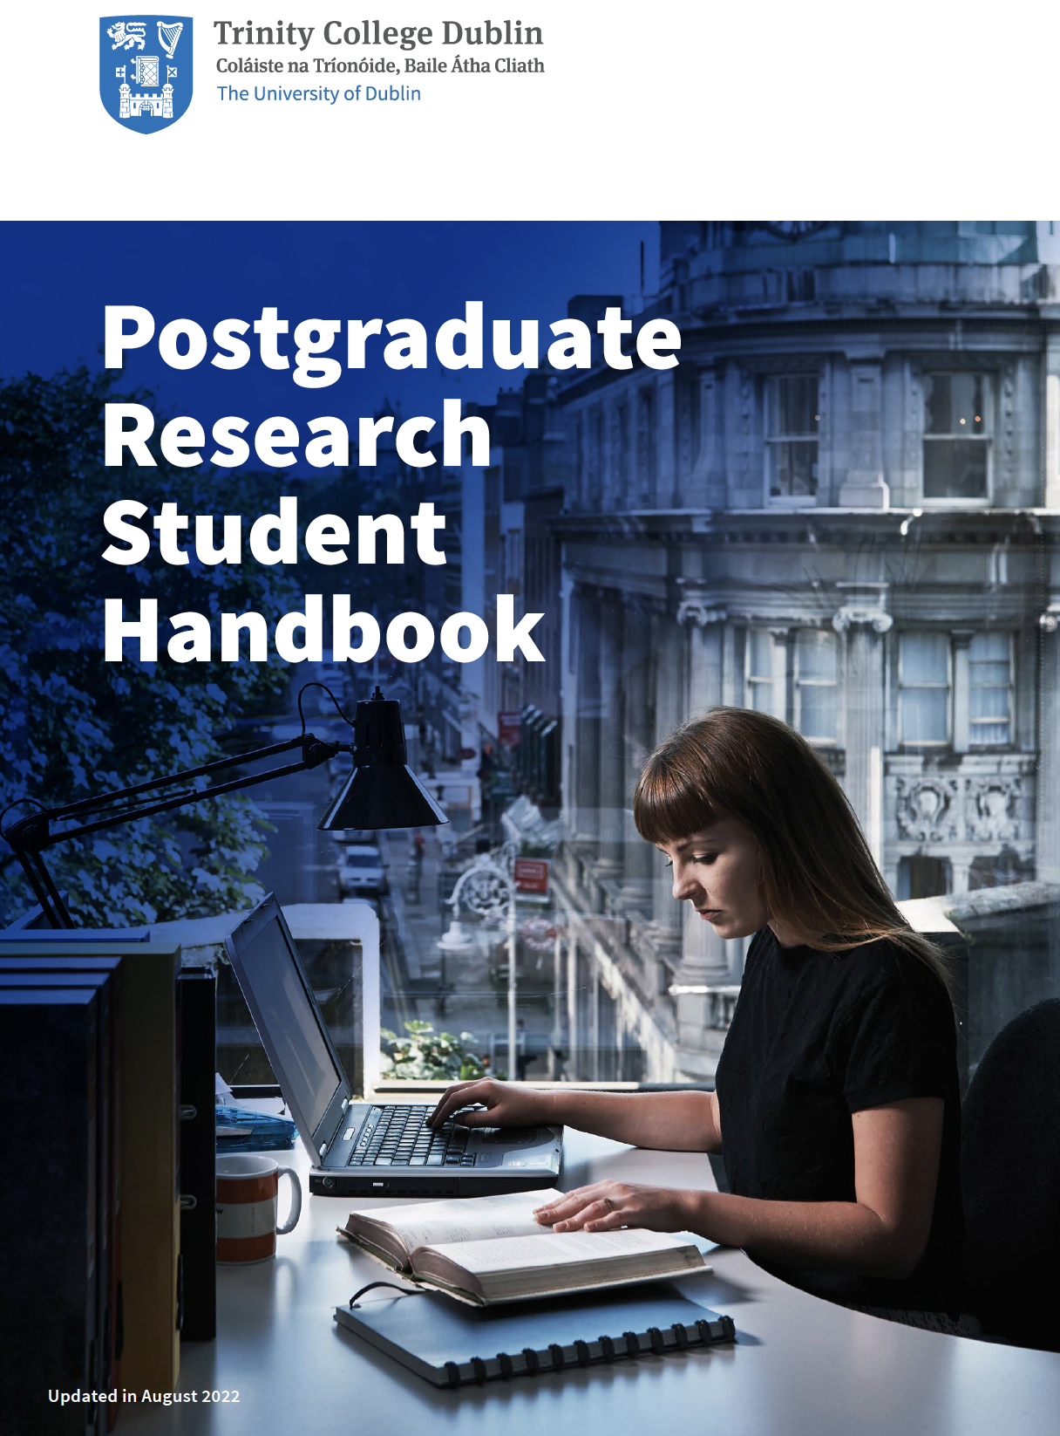
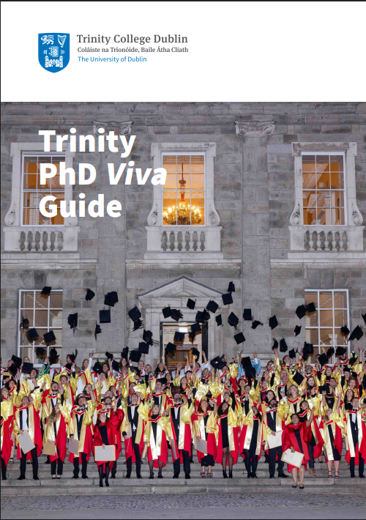

Slide 24
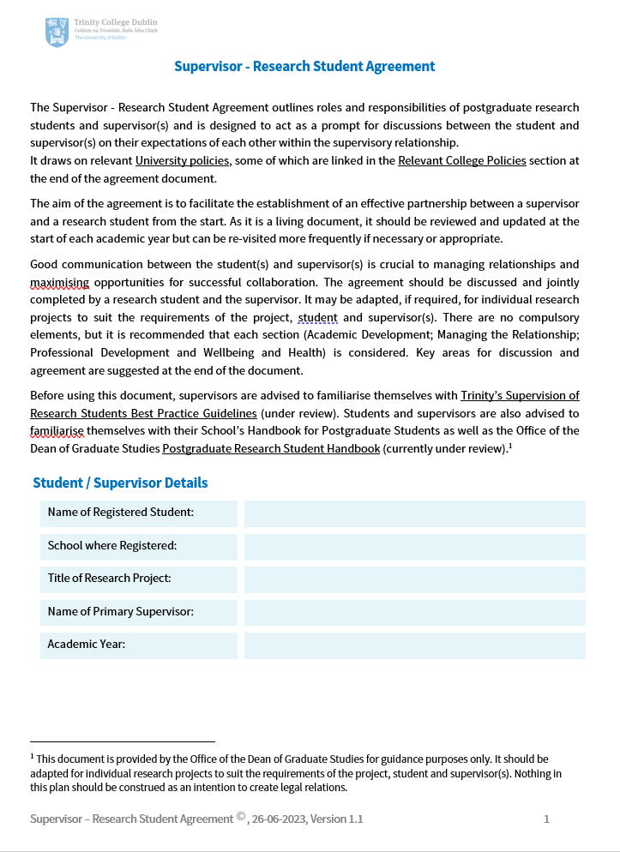
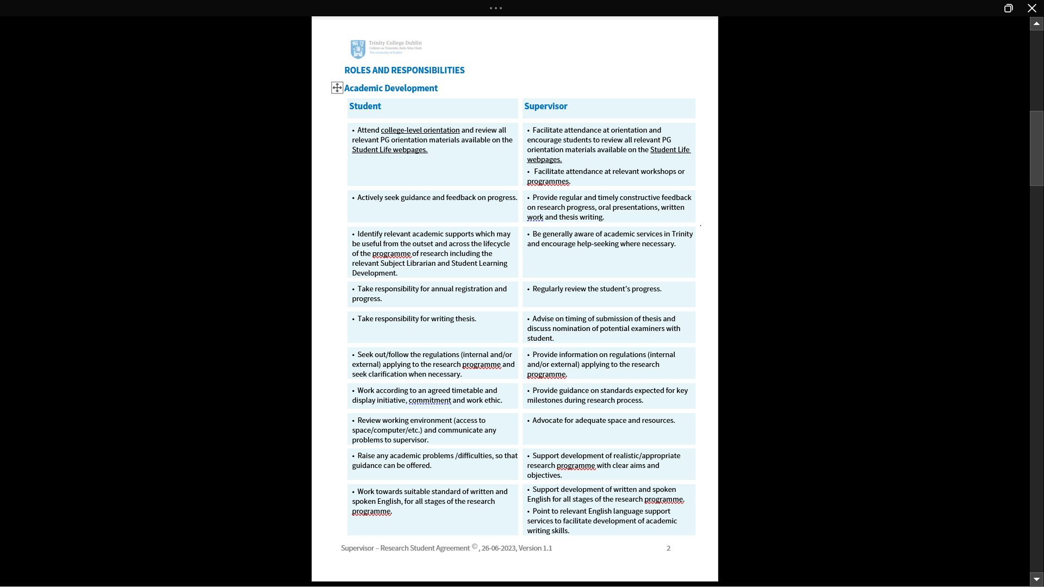
https://www.tcd.ie/graduatestudies/students/research/supervision/
Notes:
The Supervisor / Research Student Agreement has been developed to serve as a foundation for a positive and productive relationship between the supervisor and their student. It outlines the expectations for both parties and promotes a shared understanding of goals and milestones on the student journey. The agreement encourages open and transparent communication between the supervisor and the PhD student and it creates a platform for discussing concerns and addressing issues.
And this is what the agreement looks like. The last page lists useful hyperlinks to relevant University policies, handbooks, student services and other useful resources.
Pilot – TRDA recipient.

Slide 25
Thank You, Míle Buíochas
Go n’eirí libh!

